Slide 1


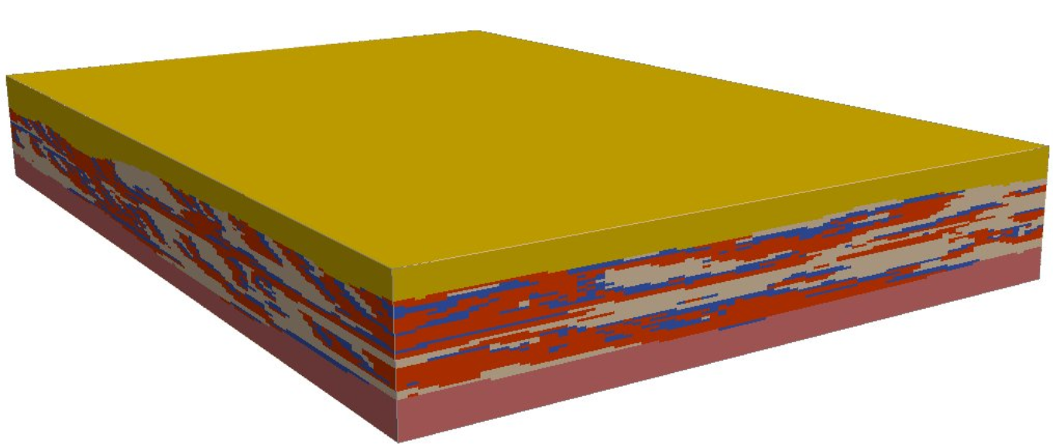


ArchPy: express-course
Ludovic Schorpp, Alexis Neven, Julien Straubhaar, Philippe Renard
27.06.2023
Notes:
Thank you, happy (and quite impressed) to see this amount of people that are interested by this course ! So this is the first time that I’m doing this so I hope it will be okay but do not hesitate to interrupt me if something is unclear, or you can ask of one of my specials assistants ;)
This course does not have the aim to be exhaustive and only presents the basic and some aspects of what can be made with ArchPy. We know that not everyone of you is familiar with python or even with programming so we will try to be as simple as necessary but as complex as possible ;) given the profile of everyone.
Let’s jump into some theory first.

Slide 2
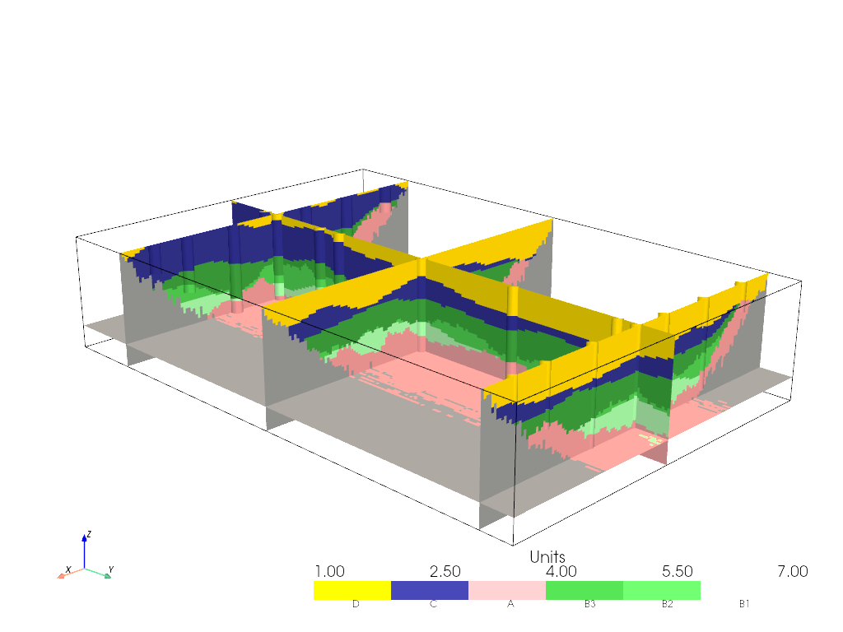
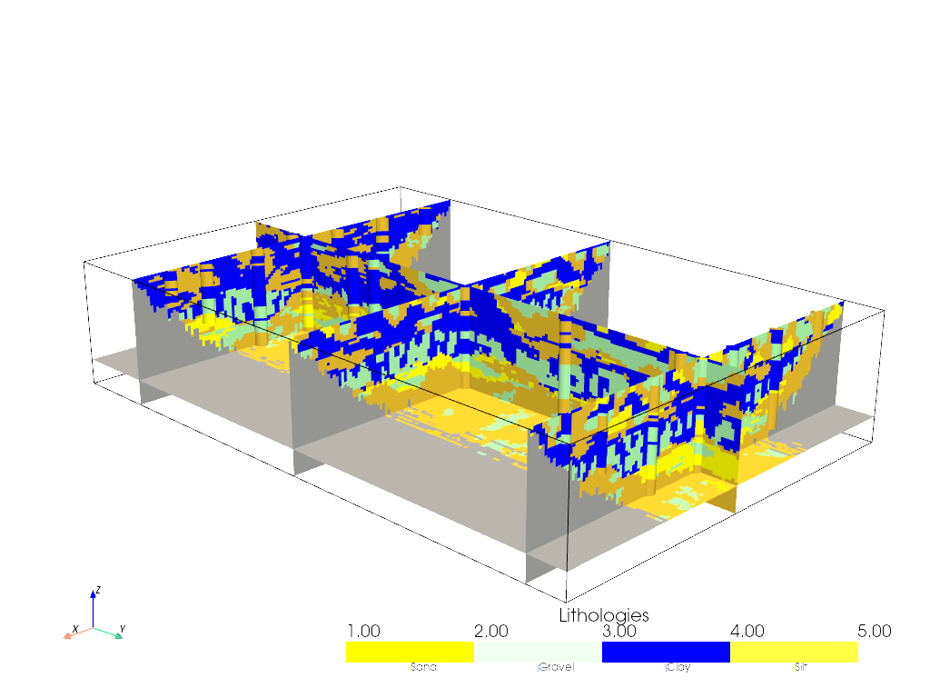
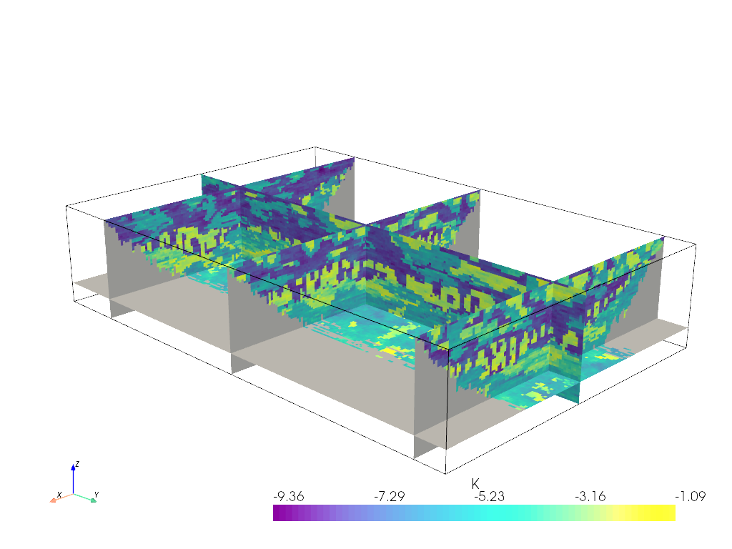
Some Theory - Hierarchy
Units
Facies
Property

Slide 3
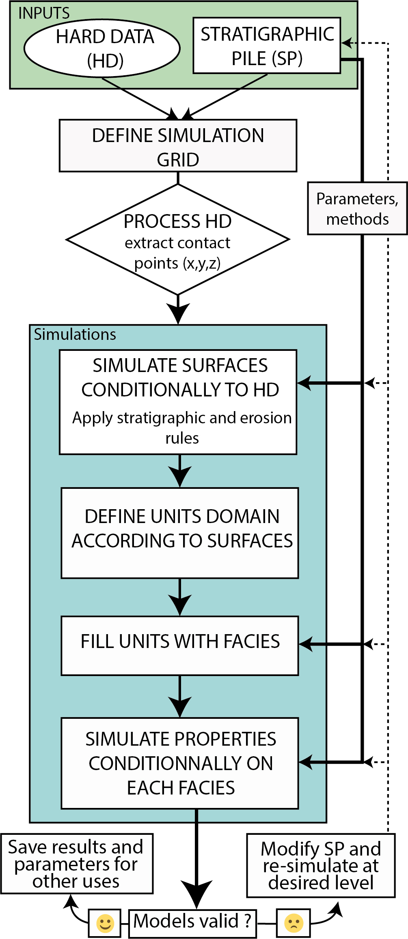
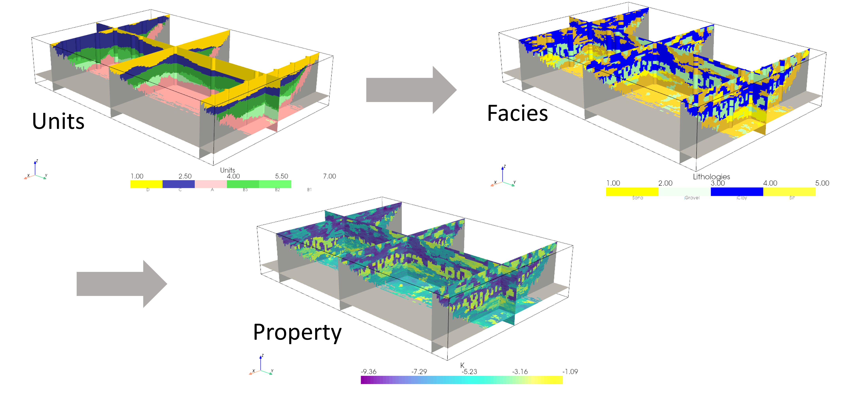
The ArchPy approach
Knowledge in a Stratigraphic Pile (SP)
Hierarchical approach
Units → hierarchical simulation
Facies
properties
Implemented in Python
Notes:
Then the Approach is called ArchPy and rely on a major concept that we call it the Stratigraphic Pile (SP). Indeed, the SP contains all the «a priori» expert knowledge such as the different units to simulate, their relation (older, younger), what kind of facies they contain etc.
The simulation use a hierarchical approach in three different steps as we just saw. At the difference that it is possible to also hierarchically simulate the units and allowing thus the simulation of sub, subsubunits etc. I will explain how this work to you right later.
Finally, as it is suggested in its name, ArchPy is implemented in full Python and freely accessible.

Slide 4
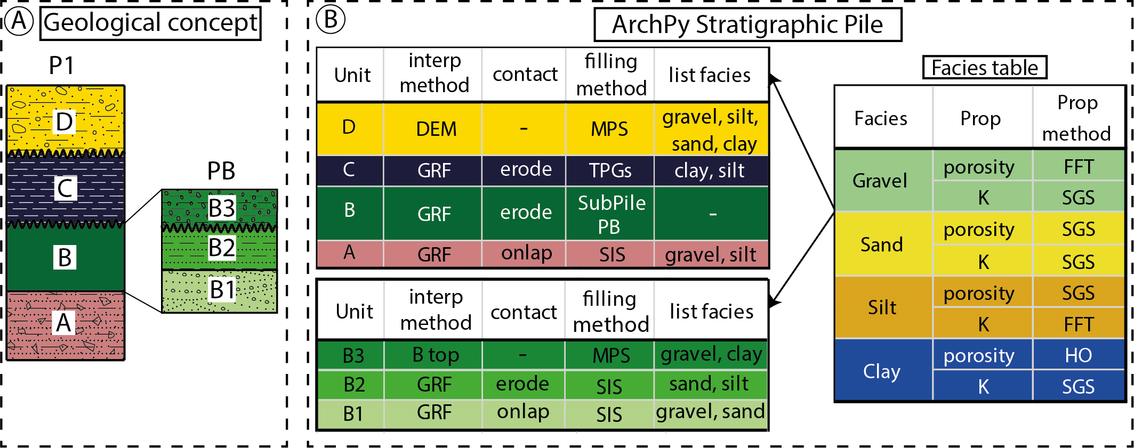
The Pile
Notes:
I will then detail to you the Stratigraphic Pile that you have here a rather complete overview with different parts. You have at the left the geological concept that define the global rules such as D unit is above C with an unconformable horizon, etc. at the right is the ArchPy SP where each object (unit, facies and properties) are informed. Let’s go through all of them.

Slide 5

The pile (Units + Surface)
A Unit object is described by different attributes :
Order
Top surface
Contact type
Interpolation method + parameters
Filling method + parameters
List of facies
Name, color, …
Notes:
Unit are major objects of ArchPy by defining the different stratigraphic unit of the model. They are described by different attributes such as the order → the position in the pile, the top surface that will be simulated and used to delimit the unit domain. This surface as a contact type (erode or onlap) and an interpolation method and associated parameters, i will come back to these after. Also a unit is defined by a list to facies contained inside the unit and a filling method to indicate to ArchPy how to fill it, finally these is other attributes such as the color, the name, the ID, etc.

Slide 6
The pile (Facies)
Facies are individual objects attached to units in which they are simulated. They have only few attributes:
Name
Color
ID
Notes:
The facies are relatively simple to define as they only required a name, a color and an ID. They are then added to the different units as we just saw.

Slide 7
The pile (Properties)
We define one property object for each simulated property. It is defined by :
A list of facies in which we want to simulate
Interpolation methods + parameters for each facies
Mean, min and max property value for each facies
Name
Notes:
Properties are individual objects and expressed the last step of the simulation process. One property object must be defined for each property to simulate (K, S, porosity). For each it is required to define a list of facies in which we want to simulate this property, as well as the interpolation methods, parameters (mean, minimal and max value). A name must also be provided to allow ArchPy to distinguish different properties.

Slide 8
The Pile (Piles)
A Pile contains different ordered (sub)units objects and can be used to integrate multiple level of units hierarchy.
Example with two piles :
Notes:
And finally there is the piles and subpiles. The advantage of using this approach is that we can define as many SP that we want and nesting them. In this example two different piles have been defined in fact, P1 and PB and they are linked to each other by the fact that the B unit is filled by the subpile PB. This means that B3, B2 and B1 units will be simulated inside B domain only and are not allow to go outside.
This procedure can be applied to any level of hierarchy if such information is available.

Slide 9
Structure of the base classes
Boreholes
Unit
Arch_table
ID, xyz, depth
Log strati
Log facies
order in pile
filling method and parameters
List facies
hard data
Name, seed
List of boreholes
Pile master
Grid, mask, etc.
List of properties
Processing functions (process bhs, computing surface, …)
Plotting functions
Pile
List of units
Type of pile (surfaces of categorical
Surface
name
surface interpolation method
erode or onlap
Geol
Property
Surfaces interpolated
unit domains
facies domains
properties
Facies
Simulation method and variograms
In which facies
ID
name
Notes:
OOP. For those of you who have some experience with programmation, ARchPy was coded using object oriented approach. Which means that we define classes from which we can generate objects that we can manipulate. The aim is to mimick the reality by using classes that makes sense to the user. And you have here the different classes used in ArchPy and their relations between each other.

Slide 10
Example 1 – simple 2D model
Goals
Getting familiar with ArchPy syntax
Building simple models from scratch
Understanding the difference between onlap and erode
Manipulating and modifying existing Archpy models

Slide 11
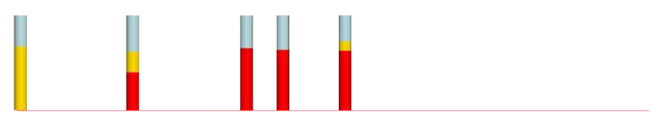
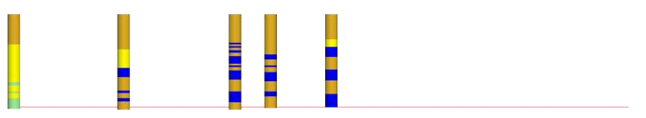
Geological concept
Boreholes
Units
2D vertical section
100 m by 15 m (Lx, Lz)
3 units:
C → Soil silts
B → Aquifer gravel and sand
A → Aquitard clay and silts
Litho-facies
Unit geological concept

Slide 12
Let’s try
Login: ccCourseE003
Password: Dico10Talien!

Slide 13
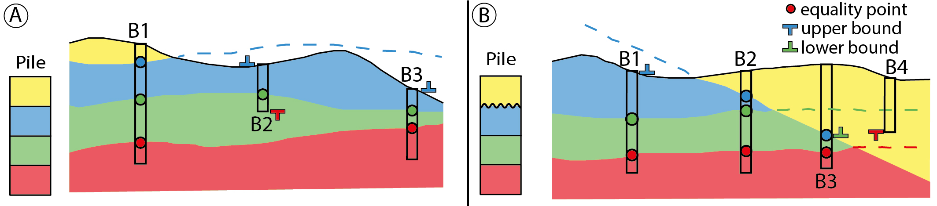
Process the data
Boreholes are processed automatically given a SP
Equality and inequality information are extracted
Facies data are also extracted

Slide 14
Geological concept
Boreholes
Units
2D vertical section
100 m by 15 m (Lx, Lz)
3 units:
C → Soil silts
B → aquifer gravel and sand
A → Aquitard clay and silts
Litho-facies
Unit geological concept

Slide 15
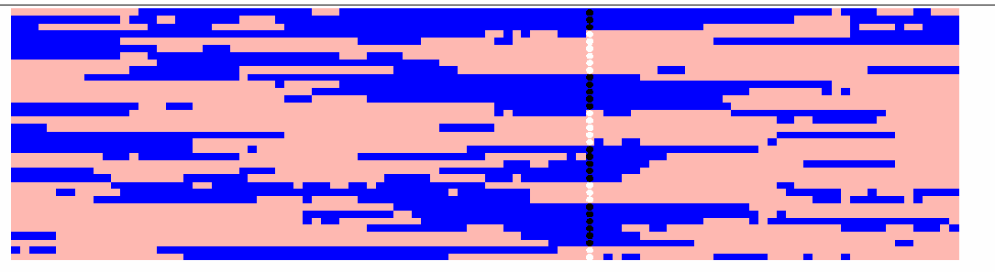
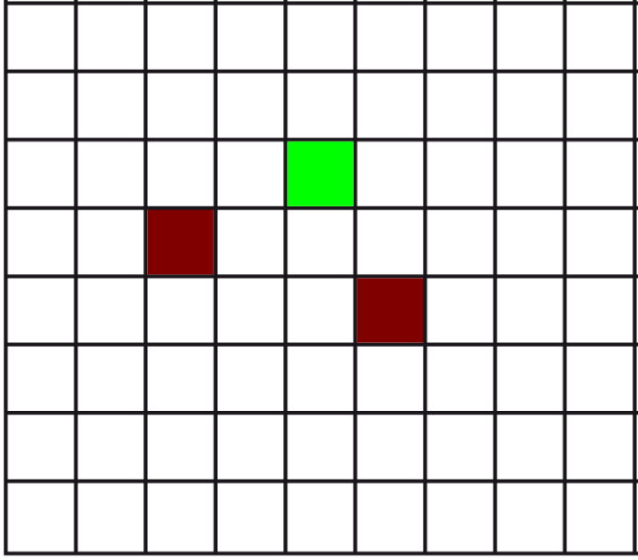
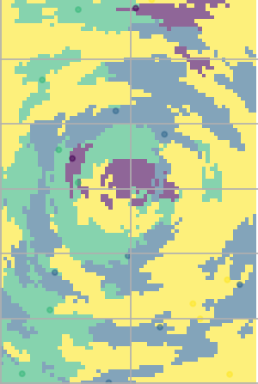
Facies simulation
SIS : Nodes are sequentially simulated conditionally to the others by indicator kriging
Easy to implement and respect proportions and variograms…
… but not very realistic
ArchPy proposes other alternatives: MPS, TPGs
Deutsch, 2006
?

Slide 16
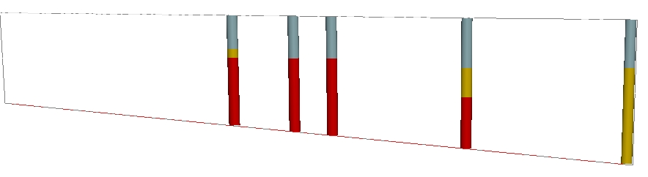
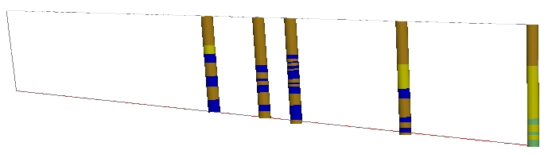
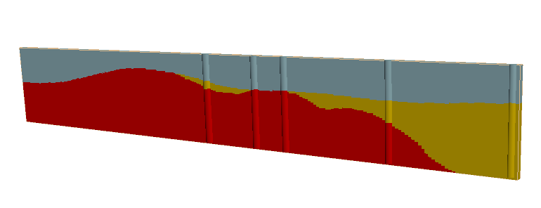
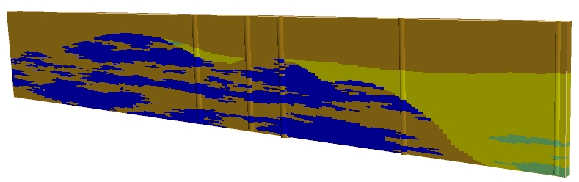
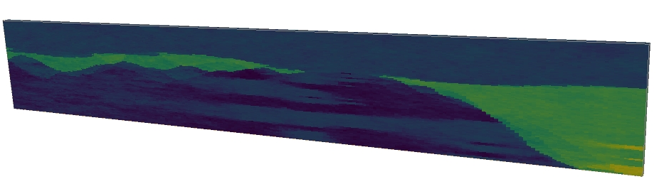
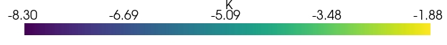
Synthesis
Log K
Notes:
Now to summarize, we have obtained different models at different geological scales as well as the uncertainty related to each of these scales.

Slide 17
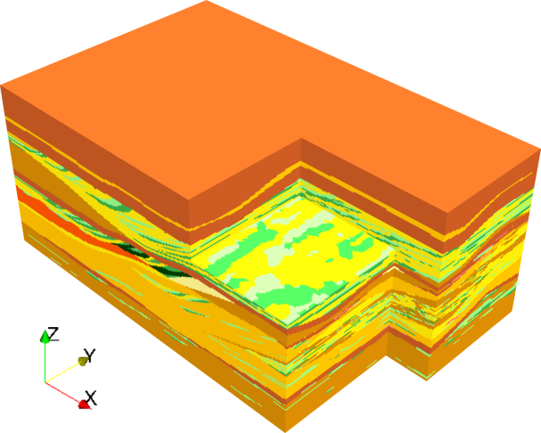
Example 2 – 3D more complex
Goals
Create complex 3D models
Use MPS to simulate both surfaces and litho-facies
Explore visualization capabilities
Comunian et al. 2011
Notes:
Let’s jump on more interesting and more complex cases.

Slide 18
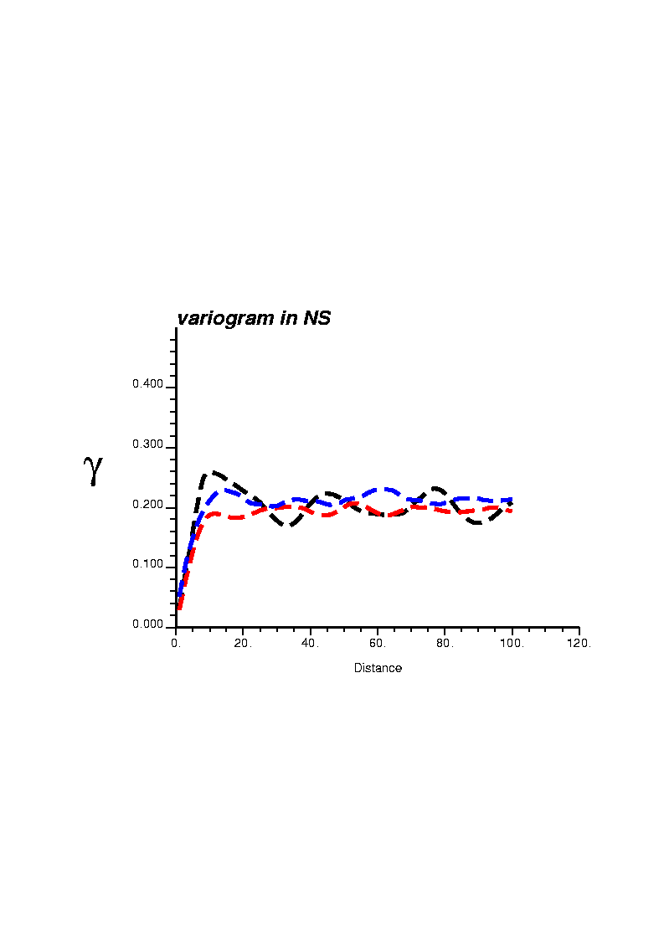
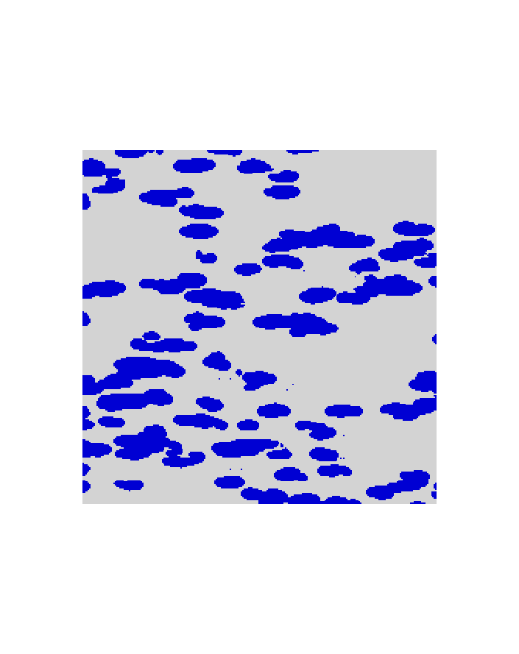
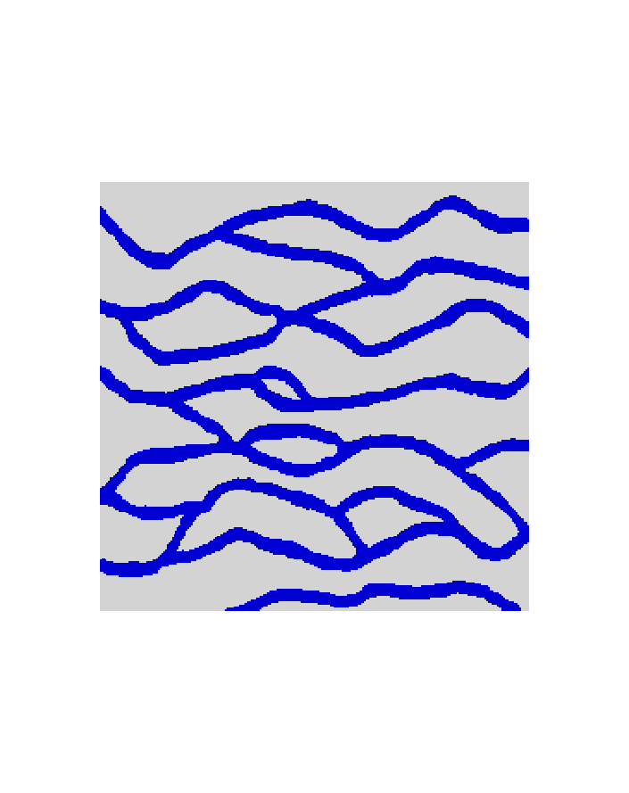
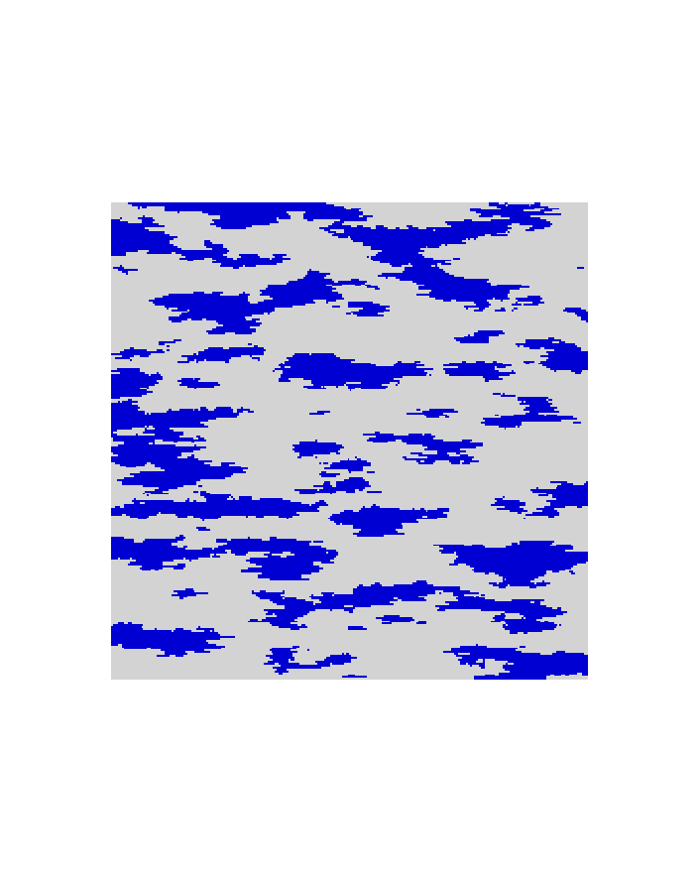
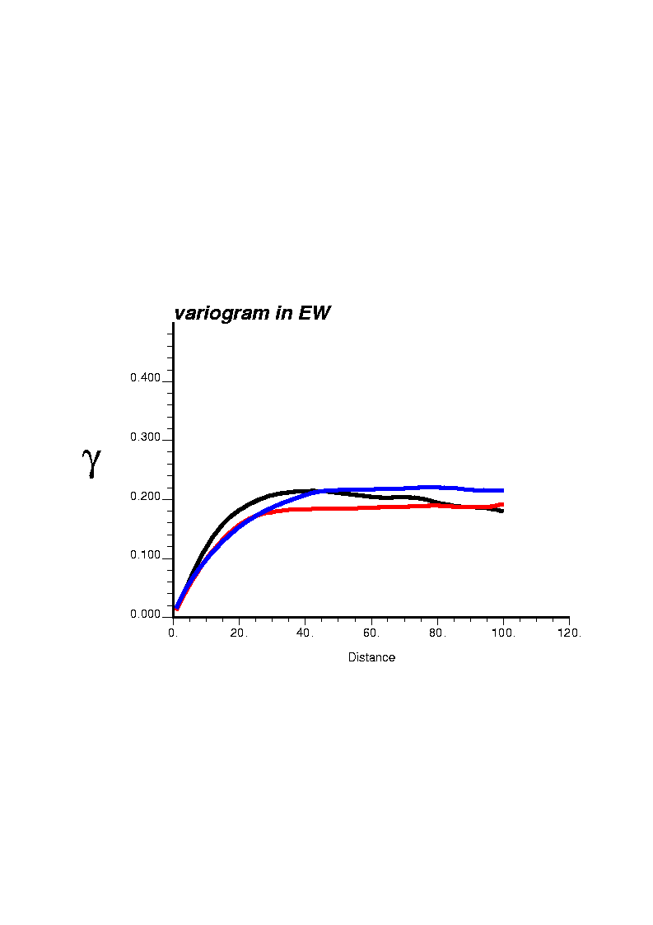
Limit of two-point statistics
similar variograms
γ(h)
Different patterns
North-South direction
h
γ(h)
1
2
3
Same proportion p = 0.28
East-West direction
h
Two-point statistics are not sufficient to distinguish complex structures
Image source: S. Strebelle, PhD Thesis, Stanford, 2000

Slide 19
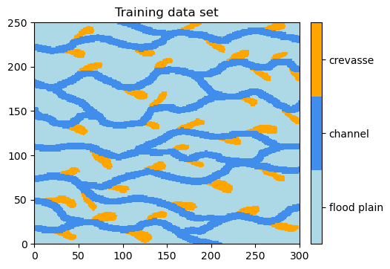
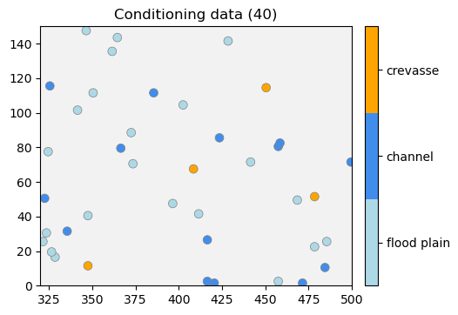
Multiple Point Statistics (MPS)
Reproducing spatial statistics of a training data set (TDS)
Patterns (n points configuration) borrowed from the TDS
Direct sampling of the TDS

Slide 20
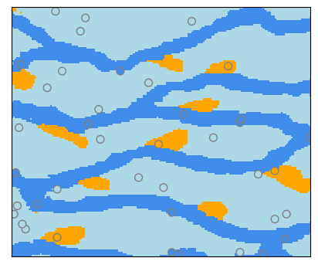
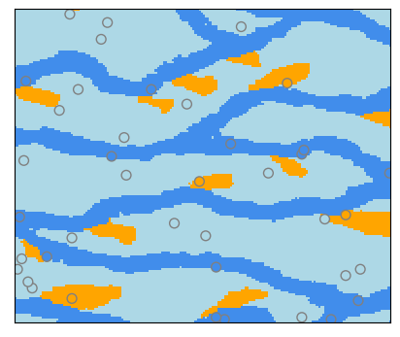
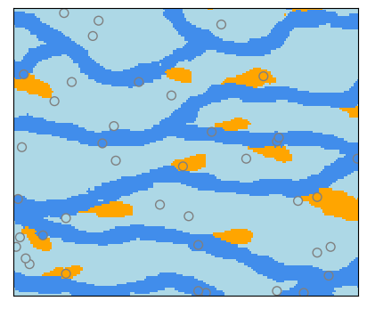
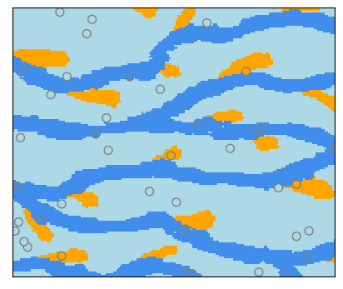
Multiple Point Statistics (MPS)
MPS → Implicit model
TDS
Reproducing spatial statistics of a training data set (TDS)
Patterns (n points configuration) borrowed from the TDS
Direct sampling of the TDS
Conditional simulations

Slide 21
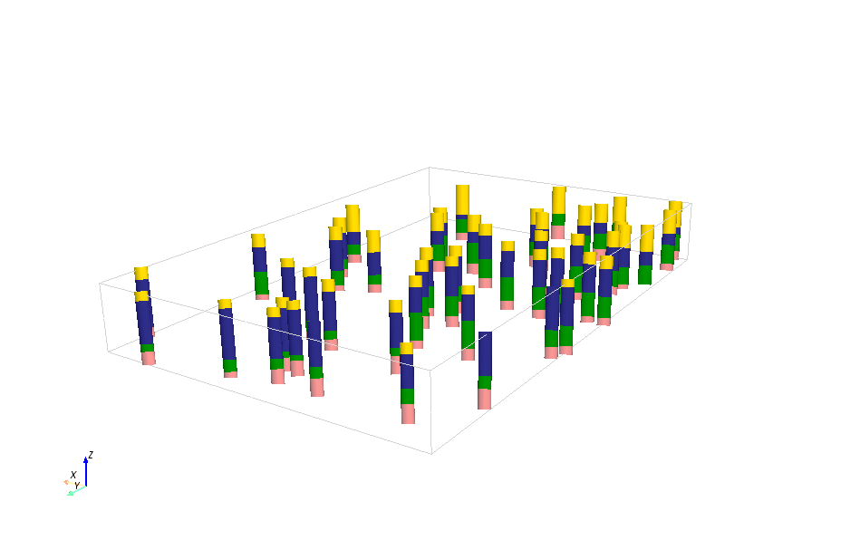
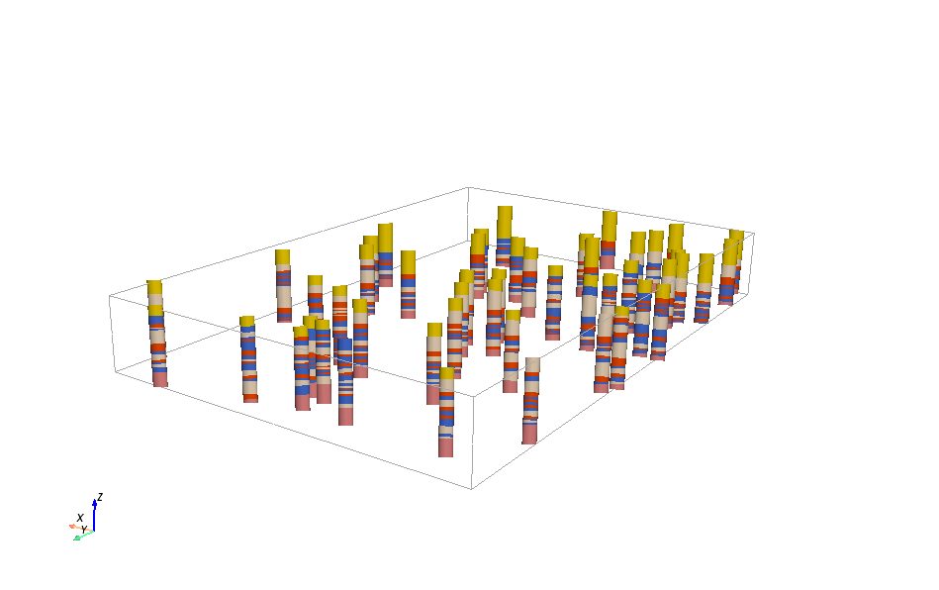
Data
Unit
Facies

Slide 22
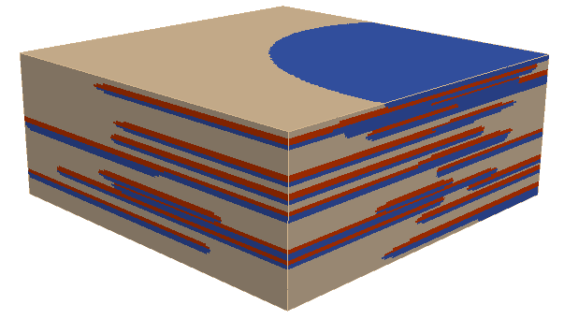
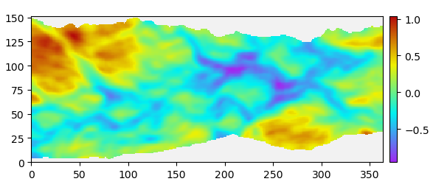
Geological concept
ArchPy Stratigraphic Pile
4 units
D: homogeneous
C: filled by MPS
B: filled by MPS
A: homogeneous
Surfaces are simulated using MPS
All contacts are onlap
Unit | Height range (min) – (max) | Interpolation method | Contact | Filling method | List of facies
D | - | - | onlap | homo. | silts
C | (- 12) – (2) | MPS | erode | MPS | open-gravel, sand, silt-matrix
B | (-14) – (0) | MPS | erode | MPS | open-gravel, sand, silt-matrix
A | (-18) – (-5) | MPS | onlap | homo. | clay
Surface info
Training dataset 2D for surface simulations

Slide 23
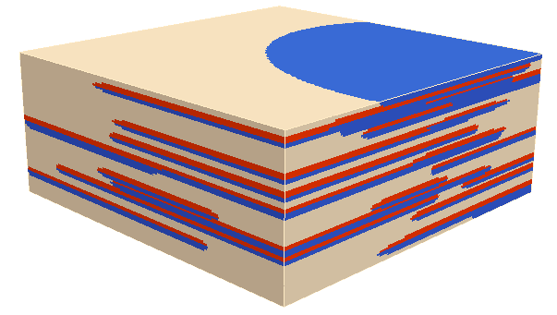
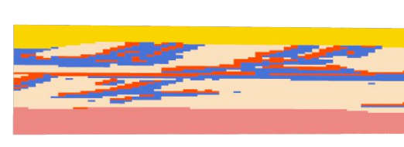
Variable orientations
Units B and C are fluvio-glacial deposits
Significant variations in facies orientation are expected
Use 3D map of orientations
Azimuth: follow the surfaces at bottom and fixed at 0° (towards N / y axis) at top
Dip: follow the gradient at bottom and fixed at 80° at top
We can fix these parameters in ArchPy !
Y

Slide 24
Example 3 – Aar model
Goals
Create a full 3D model with real data
How to use raster, shapefile, geological map
Make cross-sections
Save and load a model

Slide 25
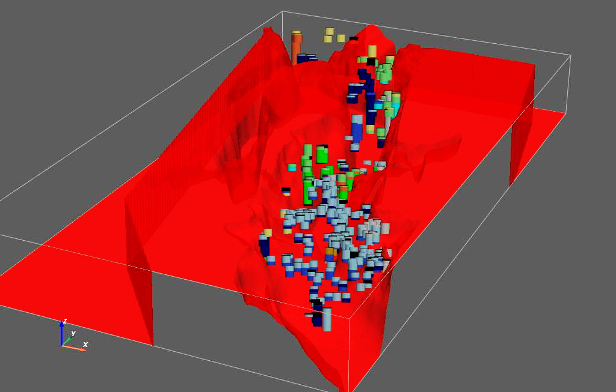
Example 3 – available data
Set of boreholes
Geological map
DEM to delimit the top
Bedrock elevation model
Shapefile for model location delimitation

Slide 26
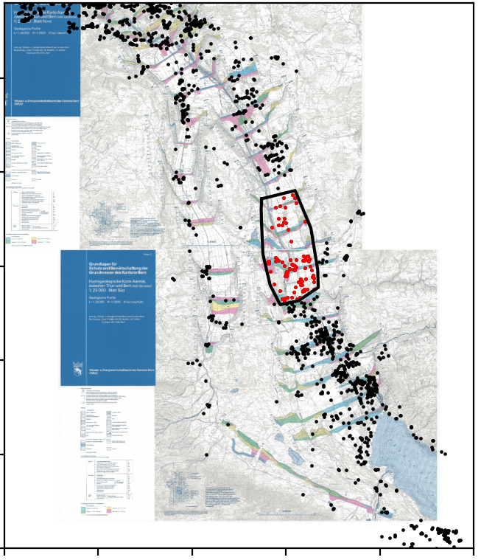
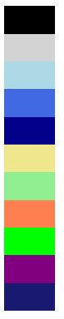
Conceptual model
Sup
Hangschutt-Bachschutt
YG
LGA
LGL
LGM
Münsingen
Glacio-lac
Bümberg
Oppligen-Sand
Alte Seetone

Slide 27
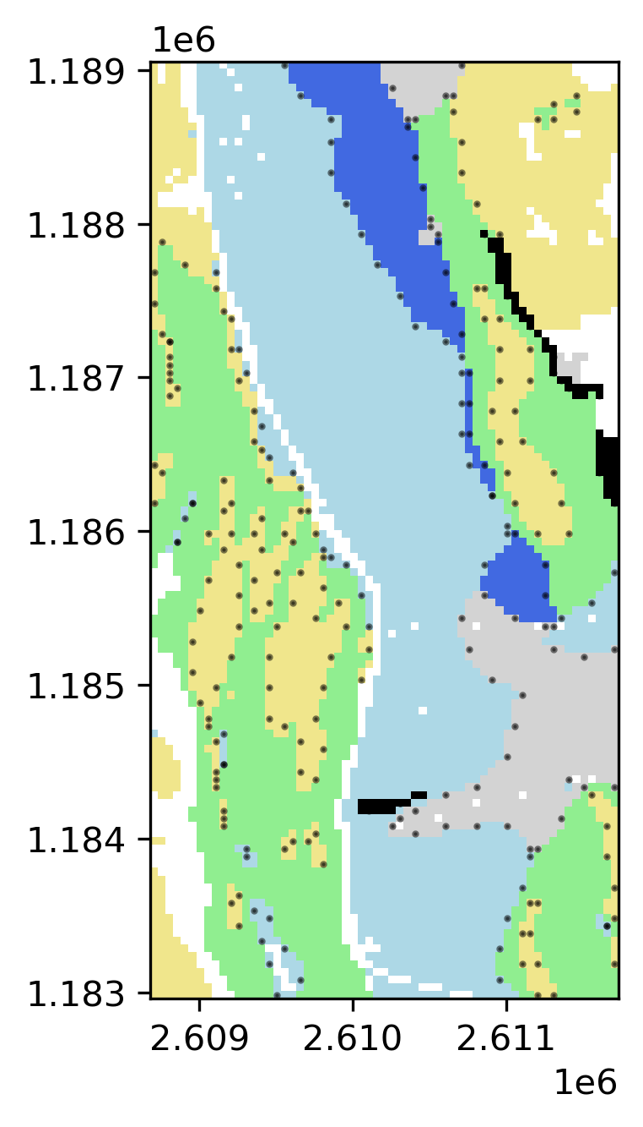

Geological map
boundaries
uniform
Geological map info can be added to ArchPy
numpy array or raster file
Values must correspond to unit IDs
Two modes of data extraction:
uniform
boundaries

Slide 29
Property simulation
Facies | Means | Interpolation method
Sand | -3.5 | SGS
Gravel | -2 | SGS
Clay | -8 | SGS
Silt | -6.5 | SGS
Log K
Define (for each facies)
Means
Variogram model
Interpolation method (FFT or SGS)
Min/max bounds (optional)

